Slide 1

Multilingual Voice Chatbot
The Multilingual Voice Chatbot represents a transformative leap in artificial intelligence, enabling effective communication across diverse linguistic landscapes.
Name | Roll no. | PRN
Harsh Chauhan | 05 | 1032222380
Heenal Shah | 12 | 1032222495
Om Joshi | 13 | 1032222500
Krishna Reddy | 17 | 1032222618

Slide 2
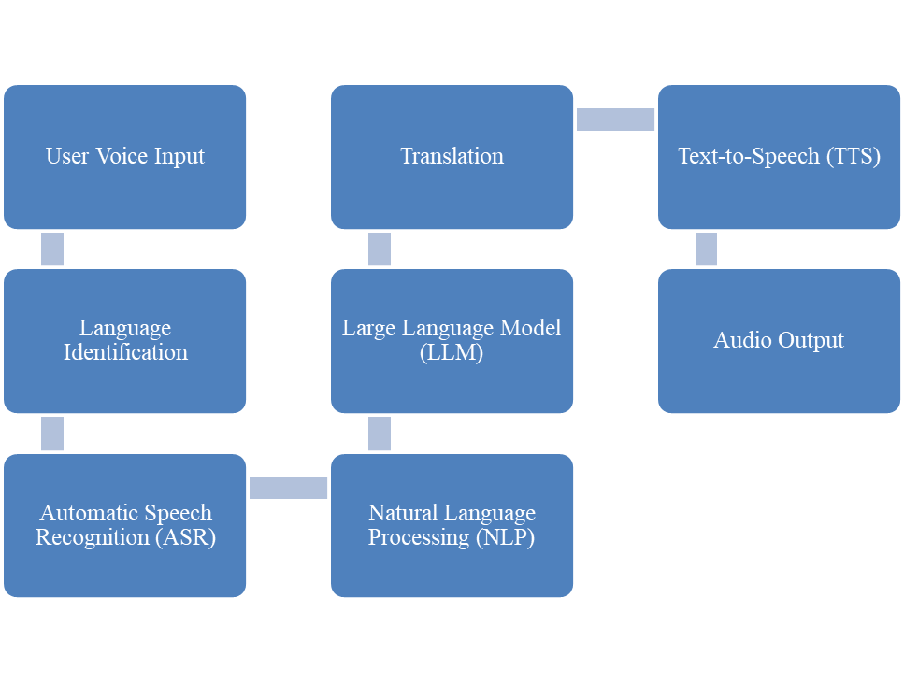
System Architecture

Slide 3
Automatic Speech Recognition (ASR)
ASR acts as the voice interpreter. It accurately converts speech into text, enabling the chatbot to understand diverse user input.
1
Language Support
2
Real-Time Processing
ASR supports various languages, allowing users to communicate naturally.
ASR processes speech in real-time, ensuring a seamless interaction.
3
Accuracy
Accurate speech recognition is crucial for understanding user intent.

Slide 4
Natural Language Processing (NLP)
NLP is the chatbot's brain, understanding the meaning behind the words.
Intention Analysis
Sentiment Analysis
Contextual Understanding
NLP identifies the user's goal or intent, providing context for a relevant response.
NLP detects the emotion behind the words, allowing the chatbot to respond appropriately.
NLP remembers past interactions, allowing the chatbot to maintain a coherent conversation.

Slide 5



Text-to-Speech (TTS)
TTS makes the chatbot's voice natural and friendly, enhancing the user experience.
Text Input
Speech Synthesis
Audio Output
The chatbot receives a text response from the NLP engine.
TTS converts the text into spoken language.
The chatbot delivers its response in the user's preferred language.

Slide 6
Large Language Models (LLMs)
LLMs power the chatbot's intelligence, allowing it to generate human-like responses.
Multilingual Capabilities
Contextual Understanding
LLMs support various languages, ensuring broad accessibility.
LLMs grasp the conversation flow, allowing the chatbot to provide relevant and consistent responses.
Adaptive Learning
LLMs constantly improve, expanding their knowledge base and adapting to new information.

Slide 7
Language Translation
Language translation bridges the gap between different languages, facilitating seamless communication.
User Input
Chatbot Response
English
English
Hindi
Hindi
Marathi
Marathi
Telugu
Telugu
Tamil
Tamil

Slide 8




Microsoft/DialoGPT-Medium
DialoGPT-Medium is a powerful conversational model trained on a massive dataset.
Conversational Flow
DialoGPT-Medium excels at generating natural-sounding and engaging responses, mimicking human conversation.
Multilingual Support
DialoGPT-Medium handles multiple languages, supporting the chatbot's multilingual capabilities.
Contextual Understanding
DialoGPT-Medium maintains context throughout the conversation, providing coherent responses.

Slide 9
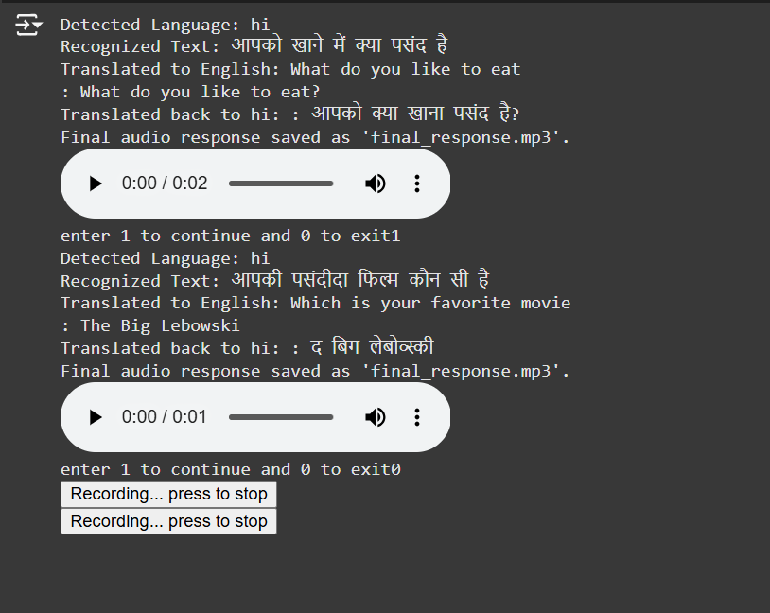
OUTPUT

Slide 10
THANK
YOU

